Slide 1
iPhone User Interface
INFO 6053

Slide 2
UI Elements
Views:
  Views provide content regions with well-defined sets of functionality
Controls:
  Graphic objects that cause instant actions or visible results.
Views and controls are all contained in the application’s single window
Users see and interact with UI elements in screens -- roughly correspond to different visual states in the application.
iPhone OS :
  defines the standard appearance of these user interface elements,
  delivers consistent behaviors that users expect.
Each application screen can contain various combinations of views and controls.
Some views include specific controls that do not belong anywhere else (Alerts, action sheets ),
And some controls can be used in a variety of views.

Slide 3
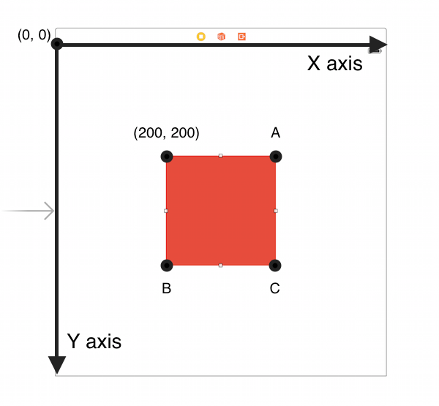
height
width

Slide 4
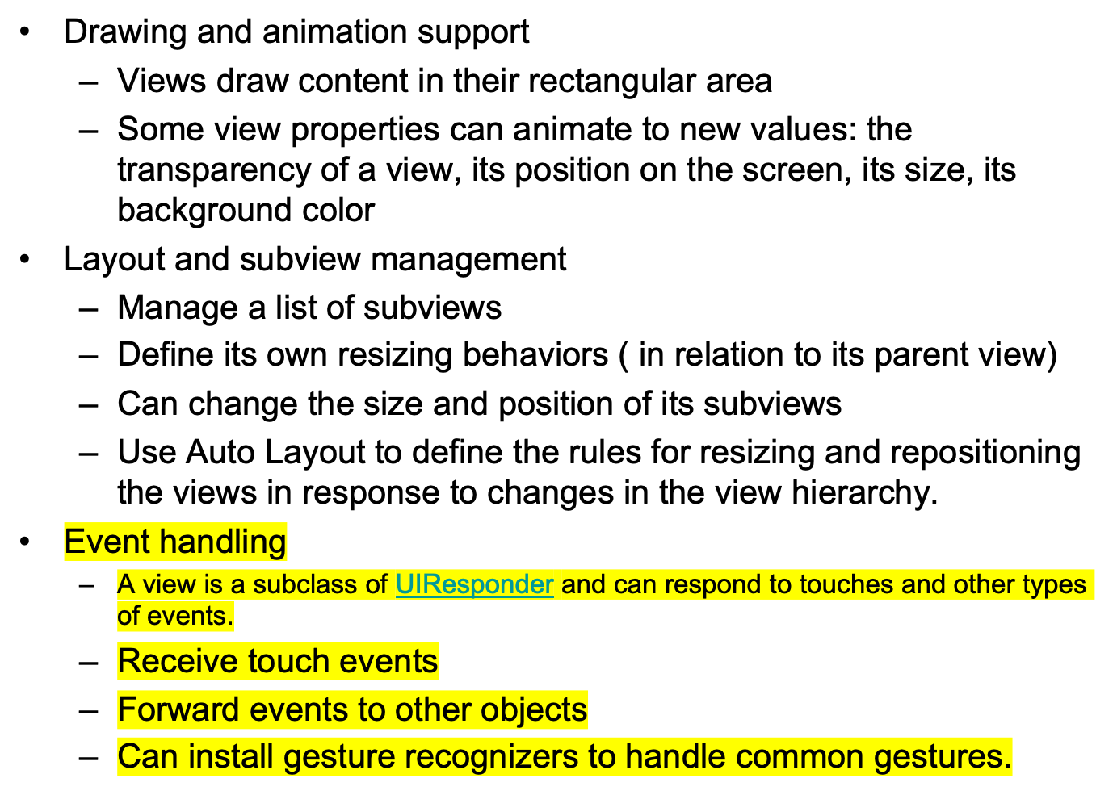
View Responsibilities

Slide 5
Views
Hierarchical
  Only one superview ----- var superview: UIView?
  Can have many (or zero) subviews --- var subviews: [UIView]
  Subview order : those later in the array are on top of those earlier
  Lower views show through transparent views sitting on top of them – Opaque by default
The hierarchy is constructed in Interface Builder
Or using code
      func addSubview(_ view: UIView)
      func removeFromSuperview()
Manage the order of subviews
- func insertSubview(_ view: UIView, at index: Int)
- func insertSubview(_ view: UIView, aboveSubview siblingSubview: UIView)
- func insertSubview(_ view: UIView, belowSubview siblingSubview: UIView)

Slide 6
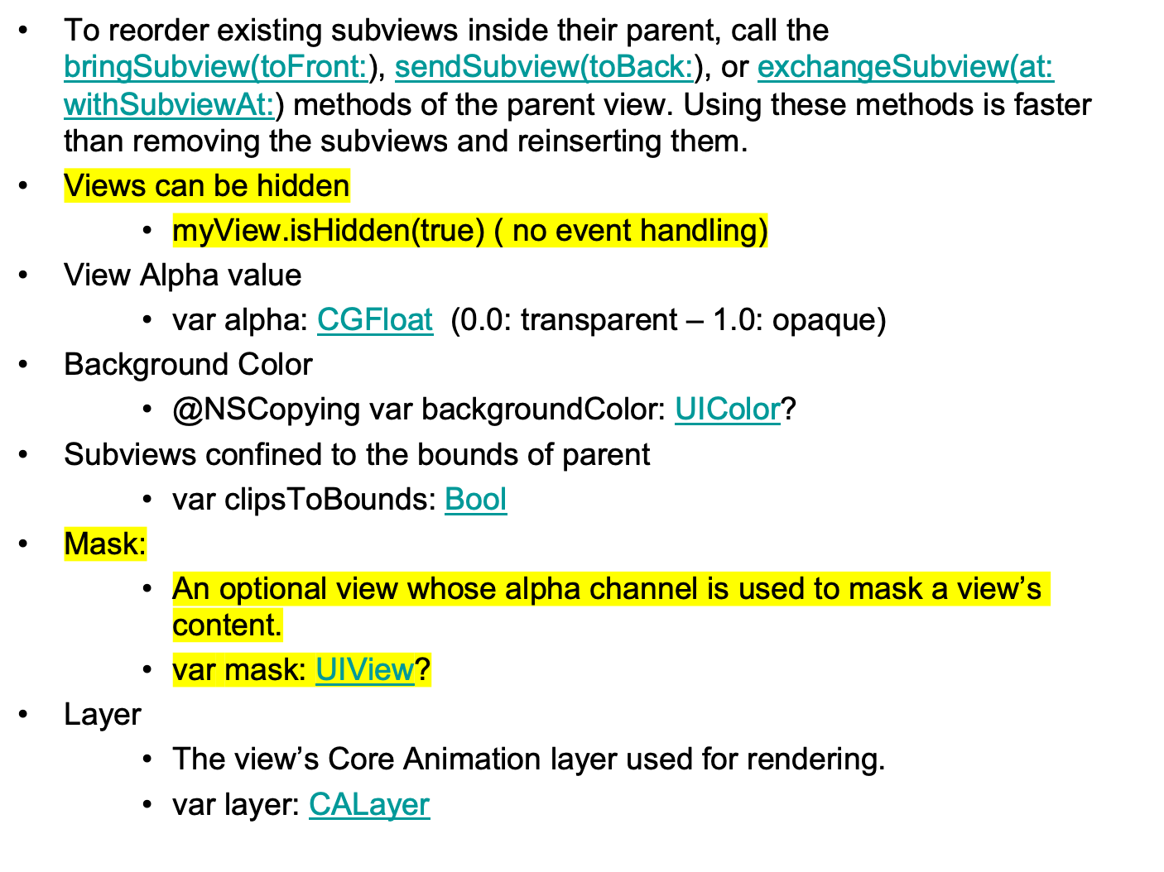

Slide 7
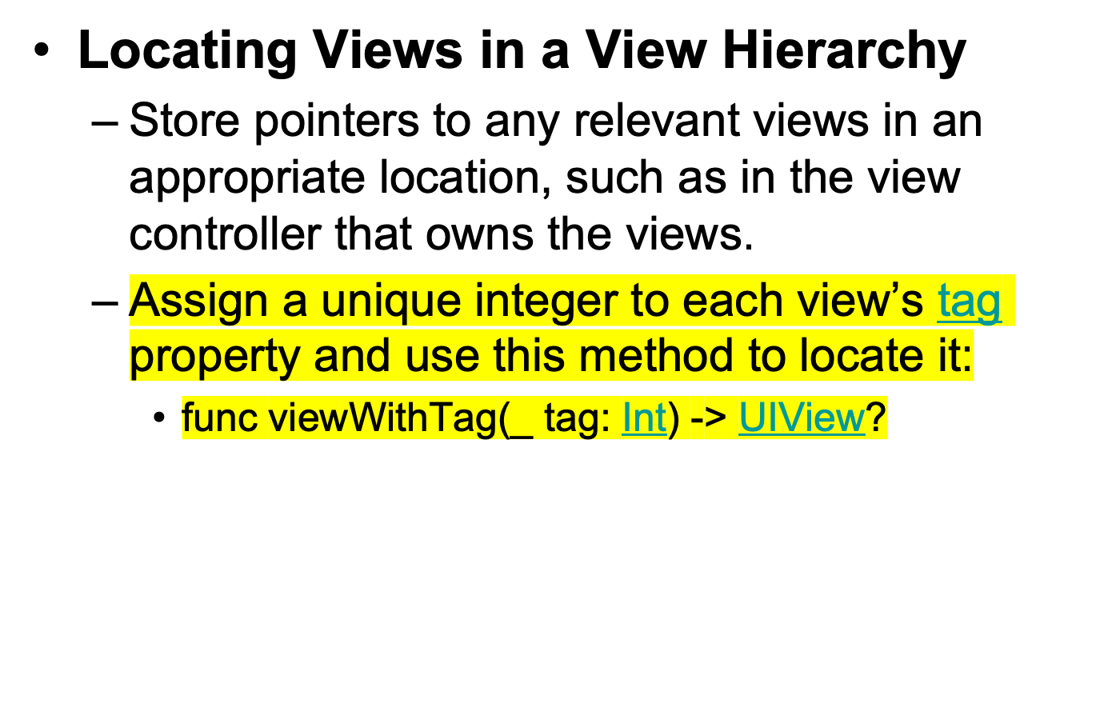

Slide 8
More properties through CLayer
borderWidth
    view.layer.borderWidth = 1.0
borderColor
    view.layer.borderColor = UIColor.blueColor().CGColor
cornerRadius
    view.layer.cornerRadius = 10.0
shadowOppacity
shadowOffset
shadowRadius
shadowColor

Slide 9
View Architecture
Views work in conjunction with Core Animation layers to handle the rendering and animating of a view’s content.
Every view in UIKit is backed by a layer object (usually an instance of the CALayer class),
CALayer manages the backing store for the view and handles view-related animations.
Most operation should be through UIView.
Operations can be performed through its layer in situations where more control over the rendering or animation behavior of your view is needed.

Slide 10
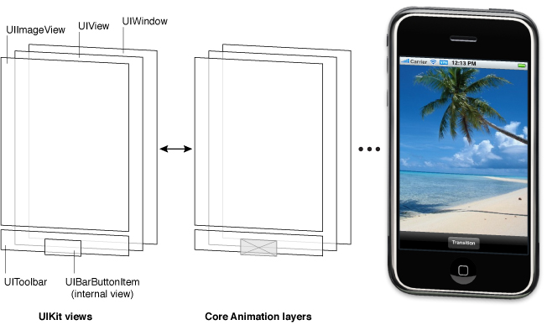
Architecture of the views in a sample application
Copyright: Apple Inc.

Slide 11
Coordinates
CGFloat
  A floating point number, used a lot in graphics. ( Double for 64bit CPU, Float for 32bit CPU)
CGPoint
  C struct with two CGFloats in it: x and y.
  var p:CGPoint = CGPoint(x:10.5, y:33.0)
  p.x -= 10 // move left by 10 points
CGSize
  C struct with two CGFloats in it: width and height.
  var s:CGSize = CGSize(width:5.0, height:70.0)
  s.height += 30 // increase the height by 30 points
CGRect
  C struct with a CGPoint as the origin and a CGSize as the size.
  var aRect:CGRect = CGRect(x:20.0, y:35.5, width:100, height:200);
  aRect.size.height += 20; // increase the height by 20 points
  aRect.origin.y+= 50; // move the rectangle down by 50 points

Slide 12
Points Versus Pixels
In iOS, all coordinate values and distances are specified using floating-point values in units referred to as points. (user coordinate space)
The measurable size of a point varies from device to device and is largely irrelevant. (one point ~= 1/160th of an inch)
Screen dimensions (in points)
iPhone and iPod touch: 320 (W) x 480 (H)
iPad 768 x 1024
At the device level, all coordinates must be converted to pixels. (device coordinate space)
The view property: var contentScaleFactor: CGFloat
      returns pixels per point on the screen this view is on.

Slide 13
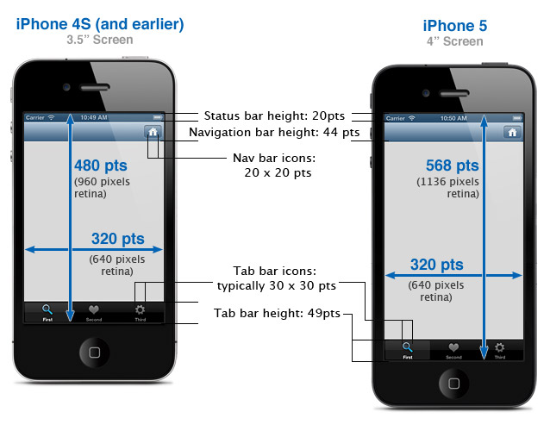
Copyright: idev101.com

Slide 14
Device Retina Portrait (px) Landscape (px)
iPhone 7+ Retina HD 1080 x 1920 1920 x1080
iPhone 7 Retina 750 x 1334 1334 x 750
iPhone 6+6+, 6S+ Retina HD 1080 x 1920 1920 x1080
iPhone 66, 6S Retina 750 x 1334 1334 x 750
iPhone 5, 6SE5, Retina 640 x 1136 1136 x 640
5S, 5C, 6SE
iPhone 44, 4S Retina 640 x 960 960 x 640
iPhone1st, No 320 x 480 480 x 320
2nd & 3rd Generation
iPad Air / Retina No 1536 x 2048 2048 x 1536
iPad1st & 2nd Generation / 3rd & 4th
iPad Pro No 2048 x 2732 2732 x 2048
iPad Retina 1536 x 2048 2048 x 1536
Mini2nd & 3rd Generation
iPadMini, No 768 x 1024 1024 x 768
1st & 2nd Generation

Slide 15
Views have 3 properties related to their location and size
var bounds: CGRect
    view’s internal drawing space’s origin and size
    The bounds property is what you use inside your view’s own implementation
var center: CGPoint
    the center of the view in your superview’s coordinate space
var frame: CGRect
    A rectangle in the superview’s coordinate space which entirely contains the view’s bounds.size
frame and center are used by the superview to position the view in the hierarchy

Slide 16
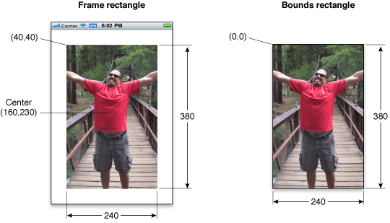
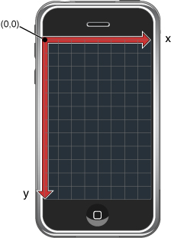
View Geometry and Coordinate Systems
(in superview’s coordinate system)
(in local coordinate system)

Slide 17
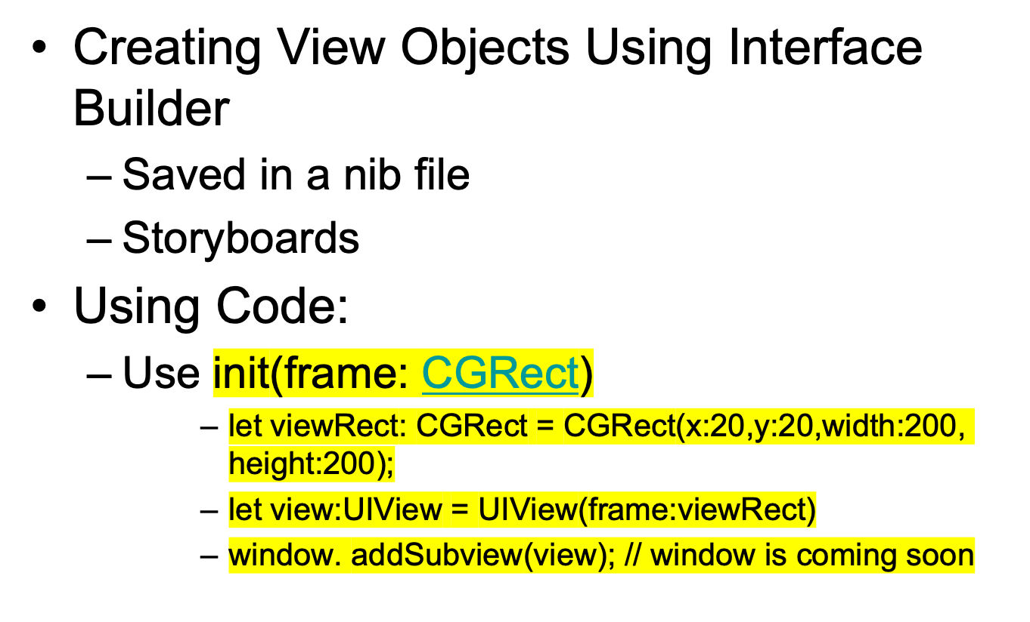
Creating and Configuring View Objects

Slide 18
Coordinate System Transformations
Coordinate system transformations offer a way to alter the view (or its contents) quickly and easily. (affine几何 transform )
Can apply affine transforms to the entire view to change the size, location, or orientation of the view relative to its superview.
Can also be used in the drawing code to perform the same types of manipulations to individual pieces of rendered content.
To modify the entire view, modify the affine transform in the transform property of the view.
To modify specific pieces of content in the view’s func draw(_ rect: CGRect), modify the affine transform associated with the active graphics context.

Slide 19
View Resizing
Whenever the size of a view changes, the size and position of its subviews must change accordingly.
The UIView class supports both:
  Automatic layout
    set the rules that each view should follow when its parent view resizes
    Set autoresizesSubviews property of the superview
  Manual layout of views in a view hierarchy.
    manually adjust the size and position of views as needed.
    The application forces layout to occur by calling the setNeedsLayout or layoutIfNeeded method of a view.
    The application forces layout by calling the setNeedsLayout method of the view’s underlying layer object.

Slide 20
View Drawing Cycle
When a view first appears on the screen, the system asks it to draw its content. The system captures a snapshot of this content and uses that snapshot as the view’s visual representation.
If the view’s content never changes, the view’s drawing code may never be called again.
When the contents of the view change, you do not redraw those changes directly. Instead, you invalidate the view using either the setNeedsDisplay or setNeedsDisplayInRect: method. These methods tell the system that the contents of the view changed and need to be redrawn at the next opportunity.

Slide 21
This is how to use transform to rotate a view by 45 degrees
// M_PI/4.0 is one quarter of a half circle, or 45 degrees
    let rotate = CGAffineTransformMakeRotation(CGFloat(Double.pi / 4))
    self.view.transform = rotate;

Slide 22
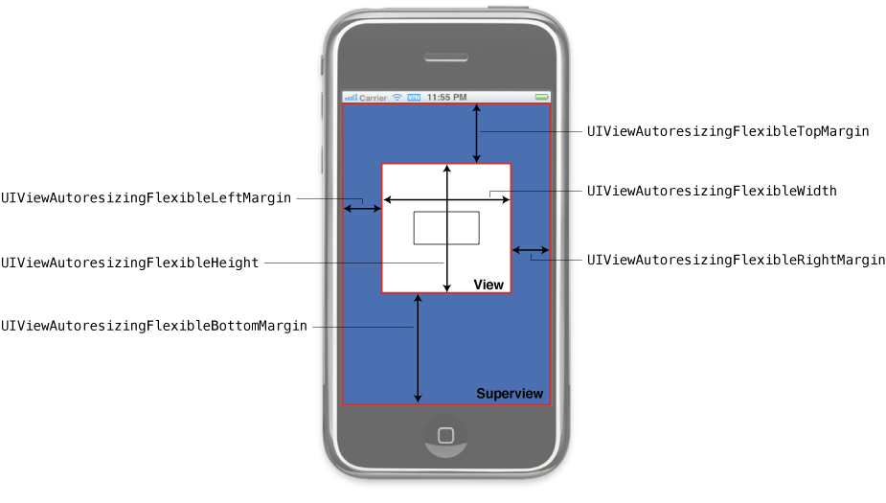
An integer bit mask that determines how the receiver resizes itself when its superview’s bounds change.
flexibleTopMargin
flexibleLeftMargin
flexibleWidth
flexibleHeight
flexibleRightMargin
flexibleBottomMargin
View Autoresizing Rules

Slide 23
Content Modes
Each view has a content mode
It controls how the view recycles its content in response to changes in the view’s geometry and whether it recycles its content at all.
The content mode of a view is applied whenever you do the following:
  Change the width or height of the view’s frame or bounds rectangles.
  Assign a transform that includes a scaling factor to the view’s transform property.
UIViewContentMode
scaleToFill, scaleAspectFit, scaleAspectFill,
redraw,
center,
top,
bottom,
left,
right,
topLeft,
topRight,
bottomLeft,
bottomRight

Slide 24
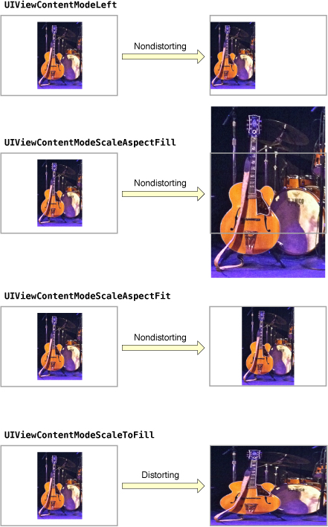
Default = scaleToFill,
Copyright: Apple Inc.

Slide 25
Relationships Between Views Expressed using Constraints
Constraints represent relationships between user interface elements such as “these views line up head to tail,” or “this button should move with this view subview.
Format: item1.attribute1 = multiplier × item2.attribute2 + constant
view1.bottom = view2.bottom – 20
myConstraint:NSLayoutConstraint = NSLayoutConstraint(
item: view1,
attribute: bottom ,
relatedBy: equal ,
toItem: view2 ,
attribute: bottom ,
multiplier: 1.0 ,
constant: -20);
Superview.addConstraint(myConstraint);

Slide 26
View Animation
The animation support built into the UIView class makes it easy to animate changes to view properties and to create animated transitions between views.
You can use the (Objective-c) transitionWithView:duration:options:animations:completion:
  when hiding, adding, or removing subviews.
  Add UIViewAnimationOptionAllowAnimatedContent option to animate all changes directly. ( no snapshots)
or transitionFromView:toView:duration:options:completion:
  methods to swap out entire sets of views for new ones. ( removes the first view)
  pass the UIViewAnimationOptionShowHideTransitionViews key to hide the first view instead of removing it.

Slide 27
View Properties that can be animated
Among the properties you can animate on a UIView object are the following:
frame—Use this to animate position and size changes for the view.
bounds—Use this to animate changes to the size of the view.
center—Use this to animate the position of the view.
transform—Use this to rotate or scale the view.
alpha—Use this to change the transparency of the view.
backgroundColor—Use this to change the background color of the view.
Use the UIViewPropertyAnimator class to perform animations. ( recommended)
  The animator operates on animatable properties of views, such as the frame, center, alpha, and transform properties, creating the needed animations from the blocks you provide.

Slide 28
Starting Animations Using the Block-Based Methods:
In iOS 4 and later, use the block-based class methods to initiate animations :
animateWithDuration:animations:
animateWithDuration:animations:completion:
animateWithDuration:delay:options:animations:completion:
Can use these methods to create a single animation that involves changes to multiple views
Use of these methods is discouraged.
Starting Animations Using the Begin/Commit Methods
in iOS 3.2 and earlier, you must use the beginAnimations:context: and commitAnimations class methods of UIView to define animation blocks.
Use of these methods is discouraged.

Slide 29
Starting Animations Using the Block-Based Methods (Swift)
class func transition(
from fromView: UIView,
to toView: UIView,
duration: TimeInterval,
options: UIViewAnimationOptions = [],
completion: ((Bool) -> Void)? = nil)
static var transitionFlipFromLeft:
static var transitionFlipFromRight:
static var transitionCurlUp: .
static var transitionCurlDown:.
static var transitionCrossDissolve:
static var transitionFlipFromTop:
static var transitionFlipFromBottom:

Slide 30
UIView.animate(
withDuration: 2,
delay: 0,
options: [UIViewAnimationOptions.autoreverse, UIViewAnimationOptions.repeat],
animations: {
view.frame = CGRect(x: 100, y: 100, width: 100, height: 50) view.backgroundColor = UIColor.blue let transform = __CGAffineTransformMake(1, 0, 0.5, 1, 0, 0)
//__CGAffineTransformMake(0, 1, 1, 0.5, 0, 0) view.transform = transform
// view.transform = transformation
}, completion: nil)

Slide 31
UIViewPropertyAnimator
The animator operates on animatable properties of views, such as the frame, center, alpha, and transform properties, creating the needed animations from the blocks you provide.
When creating a property animator object, you specify the following:
      A block containing code that modifies the properties of one or more views.
      The timing curve that defines the speed of the animation over the course of its run.
      The duration (in seconds) of the animation.
      An optional completion block to execute when the animations finish.
    UIViewPropertyAnimator(duration: 1, curve: .easeInOut) {
      view.center = {
      let x = (frame.maxX - view.frame.width / 2)
      let y = (frame.maxY - view.frame.height / 2)
      return CGPoint(x: x, y: y)
        }()
        }.startAnimation()

Slide 32
View Customization
By creating a UIView subclass
  To do custom drawing in the screen
  To handle touch events in a special way
Overwrite the method:
  draw(_:)
iOS calls draw(_:) when:
    setNeedsDisplay()
    setNeedsDisplay(_ rect: CGRect)
draw(_:) :
  uses a context to drawn into ( set by UIKit – never cache – do not free)
  Create paths (out of lines, arcs, etc.)
  Set colors, fonts, textures, line widths, line caps, etc.
  Stroke or fill the above-created paths

Slide 33
Appearance Proxies
Use an appearance proxy to set particular appearance properties for all instances of a view in the application.
Two ways to customize appearance for objects:
  for all instances :
  [[UISlider appearance] setMinimumTrackTintColor:[UIColor greenColor]];
  for instances contained within an instance of a container class:
  [[UISlider appearanceWhenContainedIn:[UIView class], nil]
setMinimumTrackTintColor:[UIColor greenColor]];

Slide 34

Tint Color

Slide 35
Windows
Every iOS application needs at least one window—an instance of the UIWindow
A window object has several responsibilities:
  It contains the application’s visible content.
  It plays a key role in the delivery of touch events to the views and other application objects.
  It works with the application’s view controllers to facilitate orientation changes.
Use the window object to convert points and rectangles to or from the window’s local coordinate system.
Use window notifications to track window-related changes.

Slide 36
Creating a Window
Automatically:
  Every new Xcode application project includes a main nib/storyboard file (usually with the name MainWindow.xib/project.storyboard or some variant thereof) that includes the application’s main window.
Programmatically in application:didFinishLaunchingWithOptions
window = UIWindow(frame: UIScreen.main.bounds)
if let window = window {
  window.backgroundColor = UIColor.white
  window.rootViewController = UIViewController()
  window.makeKeyAndVisible()
  }

Slide 37
UIScreen
An object that contains the bounding rectangle of the device’s entire screen.
You should use the properties of this object to get the recommended frame rectangles for your application’s window
Getting the Available Screens
class var main: UIScreen : device’s screen
class var screens: [UIScreen] : all of the screens attached to the device
Getting the Bounds Information
var bounds: CGRect : the bounding rectangle of the screen ( in points)
var scale: CGFloat : scale factor needed to convert from the default logical coordinate space into the device coordinate space of this screen.

Slide 38
View Examples
The status bar
  A unique view that isn’t technically part of the application window,
  An application can customize the appearance of the status bar to some extent.
The navigation bar
  Optional view that appears just beneath the status bar and can include titles, buttons, and segmented controls.
The tab bar
  Optional view that appears at the bottom edge of a screen and contains segments that activate different modes in the application.
The toolbar
  Optional view that appears at the bottom edge of a screen and includes controls that perform specific actions in the current context of the application.
Content area.
  area between the bottom of the navigation bar and the top of the toolbar or tab bar
  Can contain arbitrary views to display content, such as table views, web views, and image views.

Slide 39
Navigation Bars, Tab Bars, Toolbars, and the Status Bar
have specifically defined appearances and behaviors in an iPhone application.
Are not required to be present in every application
Use predefined styles such as the status bars
Can use a custom color or choose one of the standard colors
A Tab in a Tab Bar can be badged
iPhone OS provides numerous standard buttons for use in navigation bars and toolbars, and icons for use in tab bars.

Slide 40
Alerts, Action Sheets, and Modal Views
Are types of views that appear when something requires the user’s attention
or when additional choices or functionality need to be offered.

Slide 41
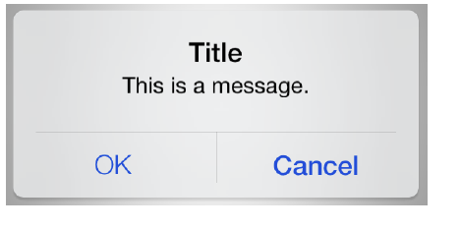
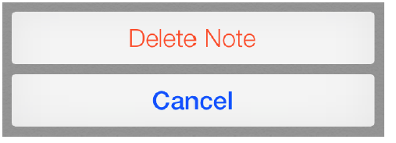

Slide 42
Table Views, Text Views, and Web Views
Versatile elements that lend themselves to different uses in your iPhone application.
Table views can be configured to display short lists of choices, grouped lists of detailed information, or long, indexed lists of items.
Text views and web views are relatively unconstrained containers to accept and display content

Slide 43
Application Controls
iPhone OS provides several controls that can be used in an application
Many of these controls are intended for use in specific places, such as in a table view, but some are available for more general usage.

Slide 44
Activity Indicators
  shows the progress of a task or process that is of unknown duration
Date and Time Pickers
Detail Disclosure Buttons
  reveals additional or more detailed information about something
Info Buttons
  provides a way to reveal configuration details about an application
Labels
  variably sized amount of static text
Page Indicators
  displays a dot for each currently open view in an application
Pickers
  generic version of the date and time picker
Progress Views
  shows the progress of a task or process that has a known duration
Rounded Rectangle Buttons
  versatile buttons that can be used in a view to perform an action
Search Bars
Segmented Controls
  a linear set of segments, each of which functions as a button that can display a different view
Sliders
  allows users to make adjustments to a value or process throughout a range of allowed values
Text Fields
  a rounded rectangular field that accepts user input

Slide 45


- Create a window and set its background color
window = UIWindow(frame: UIScreen.main.bounds)
window.backgroundColor = UIColor.lightGray
…
window.makeKeyAndVisible()
let rect:CGRect = CGRect(x:150,y:50,width:100,height:50)
let label:UILabel = UILabel(frame: rect)
label.text=" Hello world"
let btn:UIButton = UIButton(frame: CGRect(x: 100, y: 450, width: 200, height: 40))
btn.setTitle("Animate", for: UIControlState.normal)
btn.layer.cornerRadius = 20.0
btn.layer.borderColor = UIColor.red.cgColor
btn.layer.borderWidth = 2.0
btn.backgroundColor = UIColor.brown
btn.addTarget(self, action:#selector(self.rotateView), for: .touchUpInside)

Slide 46

func createTextField() -> UITextField {
let textField = UITextField(frame: CGRect(x:100.0, y:350.0, width:200.0, height:30.0))
textField.textAlignment = NSTextAlignment.center
textField.textColor = UIColor.blue
textField.backgroundColor = UIColor.white
textField.borderStyle = UITextBorderStyle.line
textField.autocapitalizationType = UITextAutocapitalizationType.words
textField.clearButtonMode = .whileEditing
textField.placeholder = "Enter text"
textField.keyboardType = .default
textField.returnKeyType = .done
textField.delegate = self
return textField
}

Slide 47
func closeWindow(sender : UIButton) {
let parentWin:UIView = sender.superview!; parentWin.removeFromSuperview()
}
func textFieldShouldReturn(_ textField: UITextField) -> Bool {
print(" You typed \(textField.text ?? "empty text")")
let alert = UIAlertController(title: "Alert", message: "Message", preferredStyle: UIAlertControllerStyle.alert) alert.addAction(UIAlertAction(title: "Ok", style: UIAlertActionStyle.default, handler: nil)) UIViewController().present(alert, animated: true, completion: nil)
textField.resignFirstResponder()
return true
}

Slide 48
UITextFieldDelegate
textFieldShouldBeginEditing(_ textField: UITextField) -> Bool:
  allow or prevent the editing of the text field’s contents
textField(_:shouldChangeCharactersIn:replacementString:)
    When current text changes
textFieldDidBeginEditing(_ textField: UITextField):
textFieldShouldClear(_ textField: UITextField) -> Bool:
    When User taps the built-in button to clear the text
textFieldShouldReturn(_ textField: UITextField) -> Bool:
    When the user taps the keyboard’s return button.
textFieldShouldEndEditing(_ textField: UITextField) -> Bool:
    Before resigning First Responder
    Use this method to validate the current text

Slide 49
TextField Notifications
UIKeyboardWillShow and
UIKeyboardDidShow
    Notifications when textField becomes first responder and the keyboard was not visible
UIKeyboardWillChangeFrame and
UIKeyboardDidChangeFrame
    If the keyboard was already visible
UITextFieldTextDidBeginEditing
UITextFieldTextDidChange
  When current text changes
UIKeyboardWillHide and UIKeyboardDidHide
  When hiding the keyboard

